Slide 1
Steganography Tool using Image Encryption & Decryption
CAPSTONE PROJECT
Presented By: Adwait Deshpande
Student Name : Adwait Deshpande
College Name & Department : Msc Digital Forensics and Information Security, NFSU, Goa

Slide 2
OUTLINE
Problem Statement
Technology used
Wow factor
End users
Result
Conclusion
Git-hub Link
Future scope

Slide 3
Problem Statement
With increasing digital communication, securing sensitive information is crucial. This project enables users to hide messages inside images securely and retrieve them using a password-protected mechanism.

Slide 4
Technology used
- Python (Tkinter, OpenCV)
- Image Processing
- Steganography Techniques
- Graphical User Interface (GUI)

Slide 5
Wow factors
- Password-Protected Encryption & Decryption
- Simple and User-Friendly GUI
- Works with Any Image File
- Prevents Unauthorized Access
- Hidden Message Cannot be Seen Normally

Slide 6
End users
- Individuals for Private Communication
- Cybersecurity Professionals
- Journalists & Activists (Secure Messaging)
- Educational Institutions (Learning Steganography)

Slide 7
Results
Users can successfully encrypt and decrypt hidden messages inside images securely using a simple GUI with password protection.

Slide 8

Results

Slide 9

Results

Slide 10
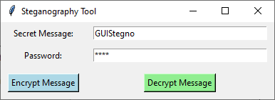
Results

Slide 11
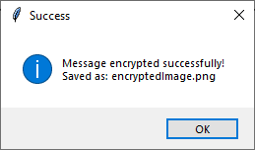
Results

Slide 12
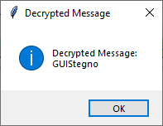
Results

Slide 13
Conclusion
This project provides a secure and efficient way to hide and retrieve sensitive information within images. It enhances privacy and ensures data remains protected from unauthorized access.

Slide 14
GitHub Link
Make sure that there should be readme file

Slide 15
Future scope(optional)
- Support for More Image Formats
- Improved Security with Advanced Encryption
- Mobile App Integration
- Cloud-Based Secure Image Storage

Slide 16
THANK YOU

